Slide 1

WEB BASED
MAINTENANCE
MANAGEMENT SYSTEM
COMPUTER SCIENCE & TECHNOLOGY
(3rd year)

Slide 2
A PROJECT REPORT
Presented by
Shubham Khan Reg no: D131490133
Animesh Dutta Chowdhury Reg no: D121359613
Sourav Mitra Reg no: D121359602
Md. Sohel Rana Reg no: D131490124
Somnath Rakshit Reg no: D131490132
Swasti Sundar Chanda Reg no: D131490127
Pratyush Bir Reg no: D121359564
Dilip Majhi Reg no: D121359599
Subhankar Gayen Reg no: D121359571
Somnath Banik Reg no: D121359612
Shilpi Debnath Reg no: D121359578
Pampa Sarkar Reg no: D121359586

Slide 3
UNDER GUIDENCE
SRABANTI CHAKRABORTY
Lecturer C.S.T Dept, EIEM

Slide 4
A special thanks to
DURGA SHANKAR DAS
WEB Mngr., EIEM

Slide 5
SCOPE OF PROJECT
Better accountability
Less work outages
Less overtime
Keep the Lab materials information

Slide 6
INTRODUCTION
Web Based Maintenance Management System is a
process for managing, locating repairing, updating the
materials of a labotatory.
The Web Based Maintenance Management System
used to create a list of fault orders.

Slide 7
REQUIREMENT SPECIFICATION
FRONT END :
HTML 5
CSS 3
Java Script
Bootstrap
JQuery
BACK END :
PHP (Professional Edition)
MY SQL

Slide 8
OBJECTIVE

Slide 9
Department In-Charge Side
Department In-charge can register the fault from any location they will get a
fault ticket number.
Department In-charge can use the fault ticket and check the current status of
the fault.
Department In-charge can generate the time based maintenance report.
Department In-charge can check the current status of material at any time.
Department In-charge can check the repair status of material at any time.

Slide 10
Maintenance Manager Side
Maintenance Manager can register all materials cateagory wise.
Maintenance Manager can register all materials cateagory wise.
Maintenance Manager can be informed about the fault of any material of any
department very easily.
Maintenance Manager can Update all materials status.
Maintenance Manager can monitor all the fault status.
Maintenance Manager can generate the list of materials under the repair or
breakdown.
Maintenance Manager can check the current status of material department
wise at any time.

Slide 11
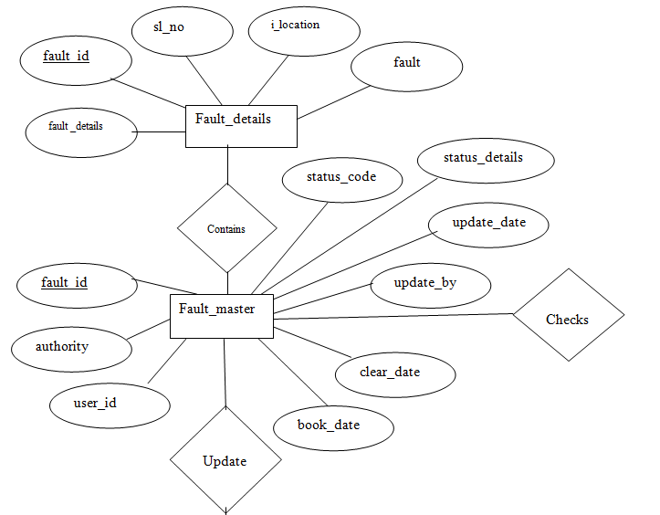
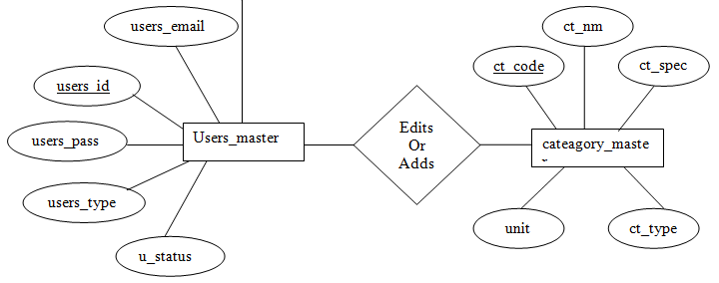
ENTITY RELETIONSHIP DIAGRAM

Slide 12
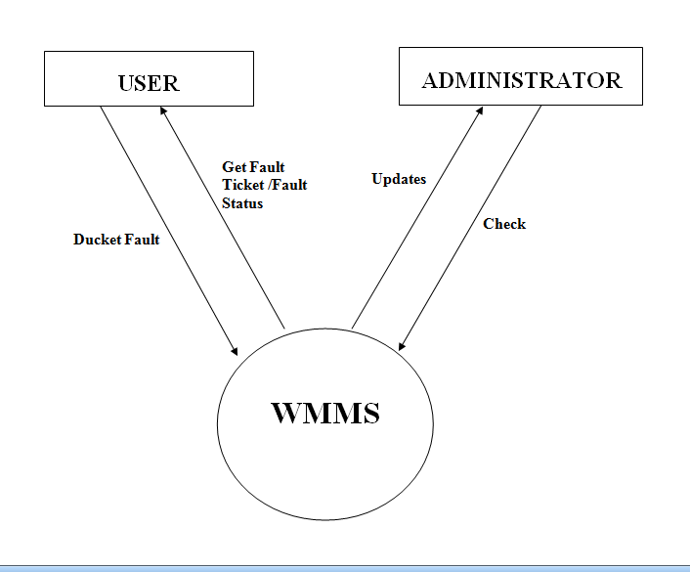
CONTEXT FREE DIAGRAM (0 Level DFD)

Slide 13
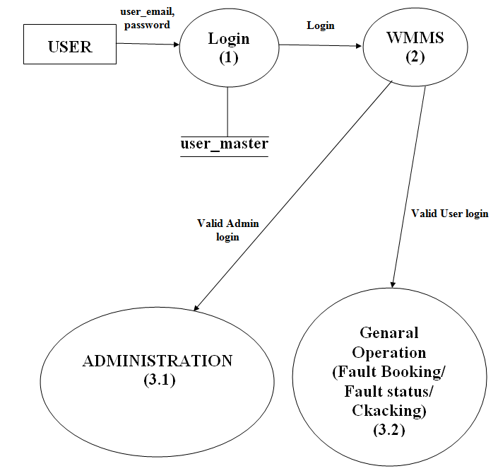
1sT Level DFD

Slide 14
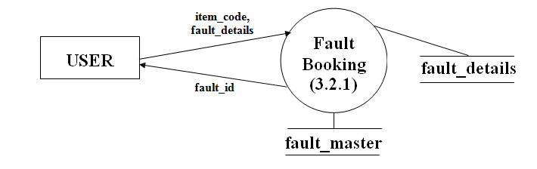
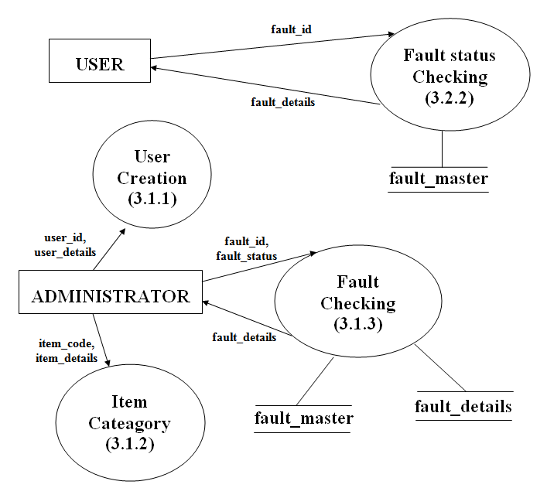
2nd Level DFD

Slide 15
DATA DICTIONARY

Slide 16
Store details about “users_master”
Field Name | Field Type | Constraint | Remarks
users_id | int(11) | Primary Key | Stores id of user
users_email | VARCHAR(255) |  | Stores email of user
users_password | VARCHAR(255) |  | Stores password of user
users_type | VARCHAR(255) |  | Stores type of user
u_status | tinyint(1) |  | Stores status of user

Slide 17
Store details about “register_user_master”
Field Name | Field Type | Constraint | Remarks
users_id | int(11) | Primary Key | Stores id of users
first_name | VARCHAR(255) |  | Stores first name of register user
last_name | VARCHAR(255) |  | Stores last name of register user
u_dept | VARCHAR(255) |  | Stores department name of register user
last_log_in | VARCHAR(255) |  | Stores last login time of register user
address | VARCHAR(255) |  | Stores address of register user
sex | VARCHAR(255) |  | Stores sex of register user
date_of_birth | date |  | Stores date of birth of register user
phon_no | int(10) |  | Stores phone no of register user
profile_pic | VARCHAR(255) |  | Stores profile image location of register user

Slide 18
Store details about “cateagory_master”
Field Name | Field Type | Constraint | Remarks
ct_code | VARCHAR(255) | Primary Key | Stores code of Category
ct_nm | VARCHAR(255) |  | Stores name of Category
ct_specification | VARCHAR(255) |  | Stores specification of Category
ct_type | VARCHAR(255) |  | Stores type of Category
unit | VARCHAR(255) |  | Stores unit of Category

Slide 19
Store details about “fault_master”
Field Name | Field Type | Constraint | Remarks
fault_id | int(11) | Primary Key | Stores id of fault item
status_code | VARCHAR(255) |  | Stores status code of fault item
status_details | VARCHAR(255) |  | Stores status details of fault item
update_date | VARCHAR(20) |  | Stores update date of fault
authority | VARCHAR(255) |  | Stores authority name of fault
update_by | VARCHAR(255) |  | Stores updater name of fault
user_id | int(11) |  | Stores id of user
book_date | VARCHAR(20) |  | Stores book date of fault
clear_date | VARCHAR(20) |  | Stores clear date of fault

Slide 20
Store details about “fault_details”
Field Name | Field Type | Constraint | Remarks
fault_id | int(11) | Primary Key | Stores id of fault item
sl_no | VARCHAR(255) |  | Stores serial number of fault item
i_location | VARCHAR(255) |  | Stores location of fault item
fault | VARCHAR(255) |  | Stores topic of fault item
fault_details | VARCHAR(255) |  | Stores details of fault item

Slide 21
Store details about “repair_master”
Field Name | Field Type | Constraint | Remarks
status_code | VARCHAR(255) | Primary Key | Stores status code of repair
status_de | VARCHAR(255) |  | Stores status details of repair

Slide 22
SCREEN SHOT

Slide 23
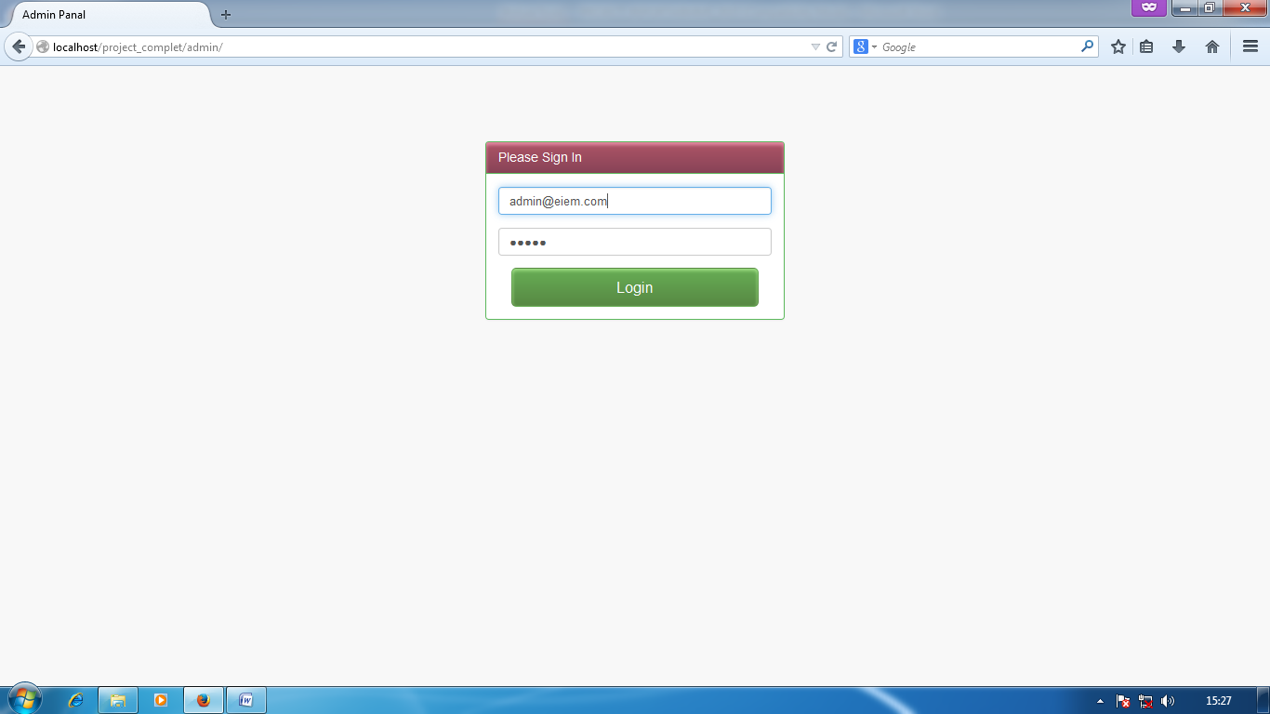
LOGIN

Slide 24
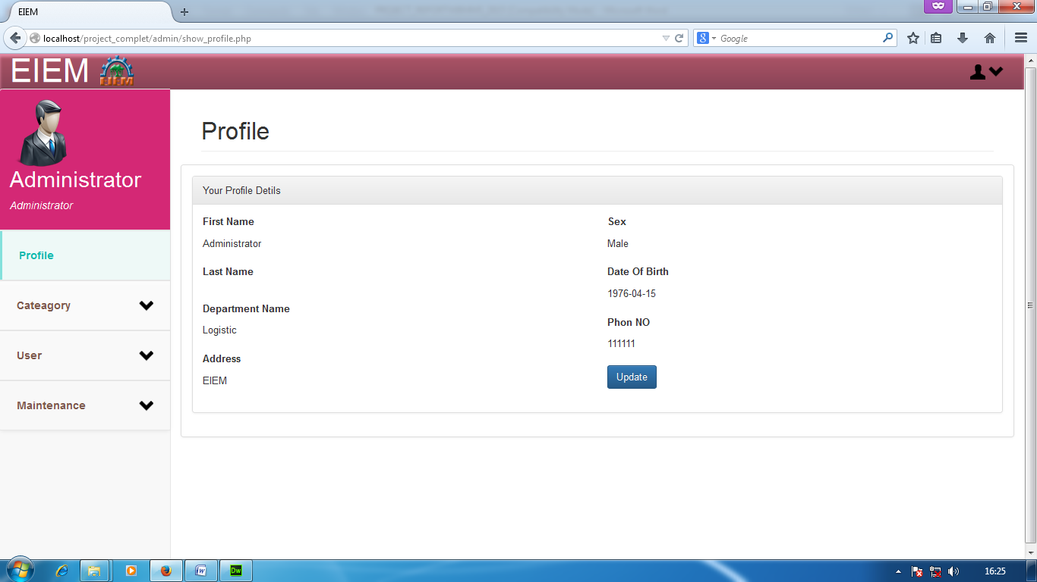
USER DEATILS

Slide 25
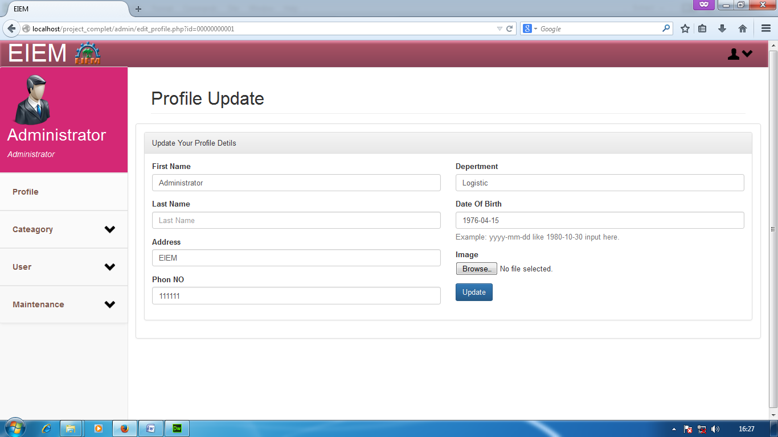
USER DEATILS UPDATE

Slide 26
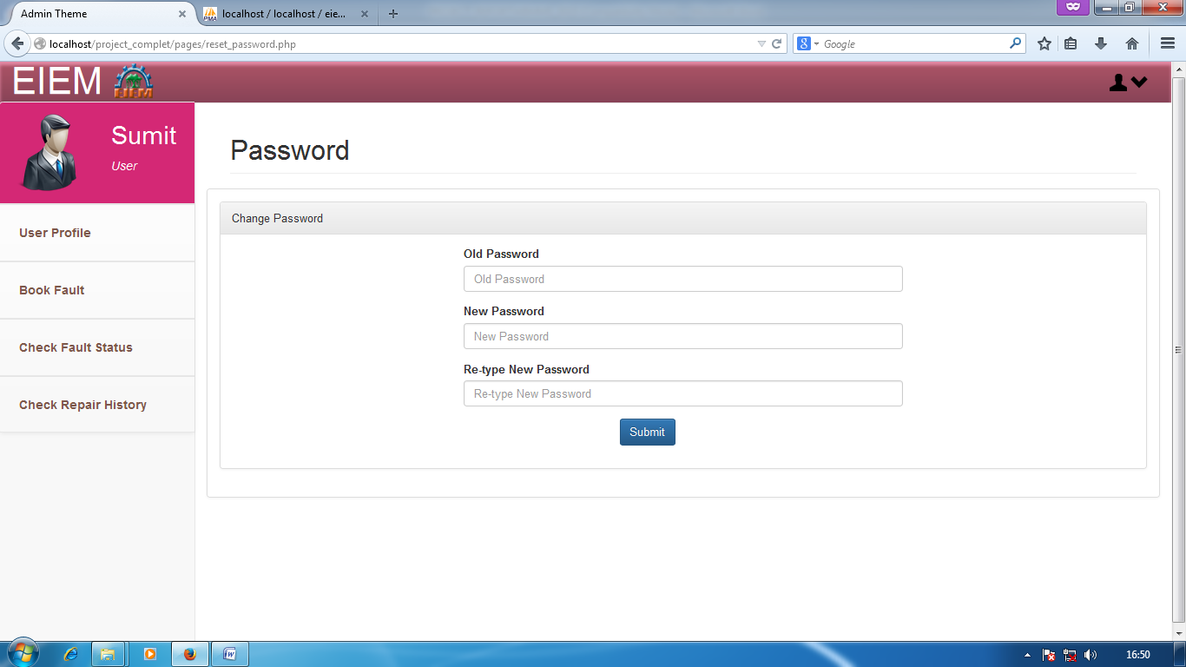
CHANGE PASSWORD

Slide 27
MODULES
ADMINISTRATOR MODULES
USER MODULES

Slide 28
ADMINISTRATOR MODULES

Slide 29
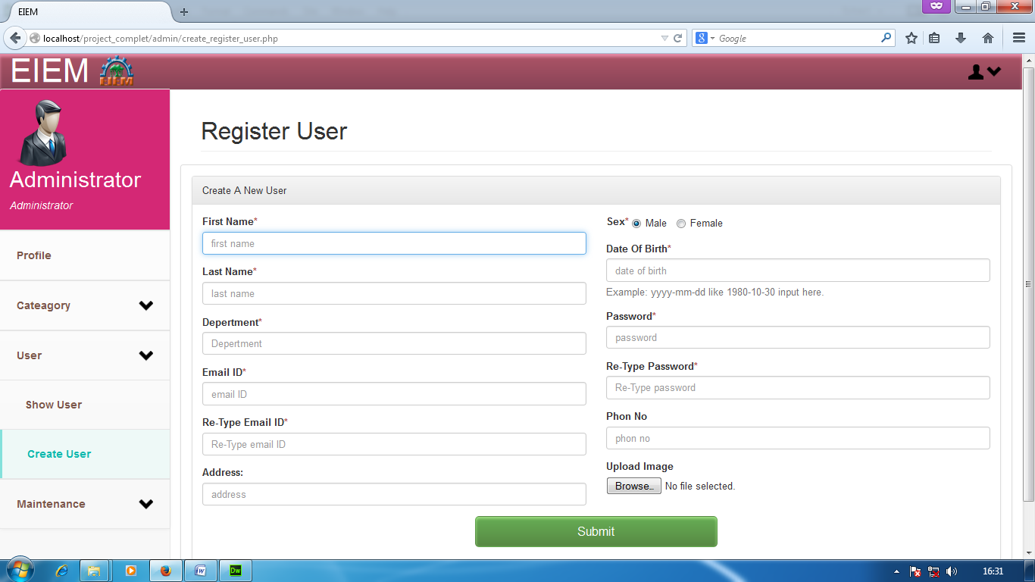
NEW USER CREATE

Slide 30
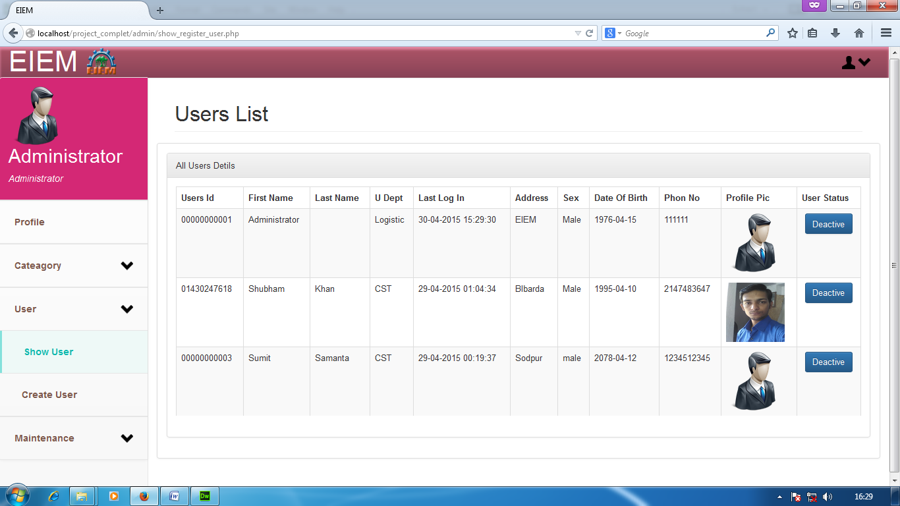
USER LIST

Slide 31
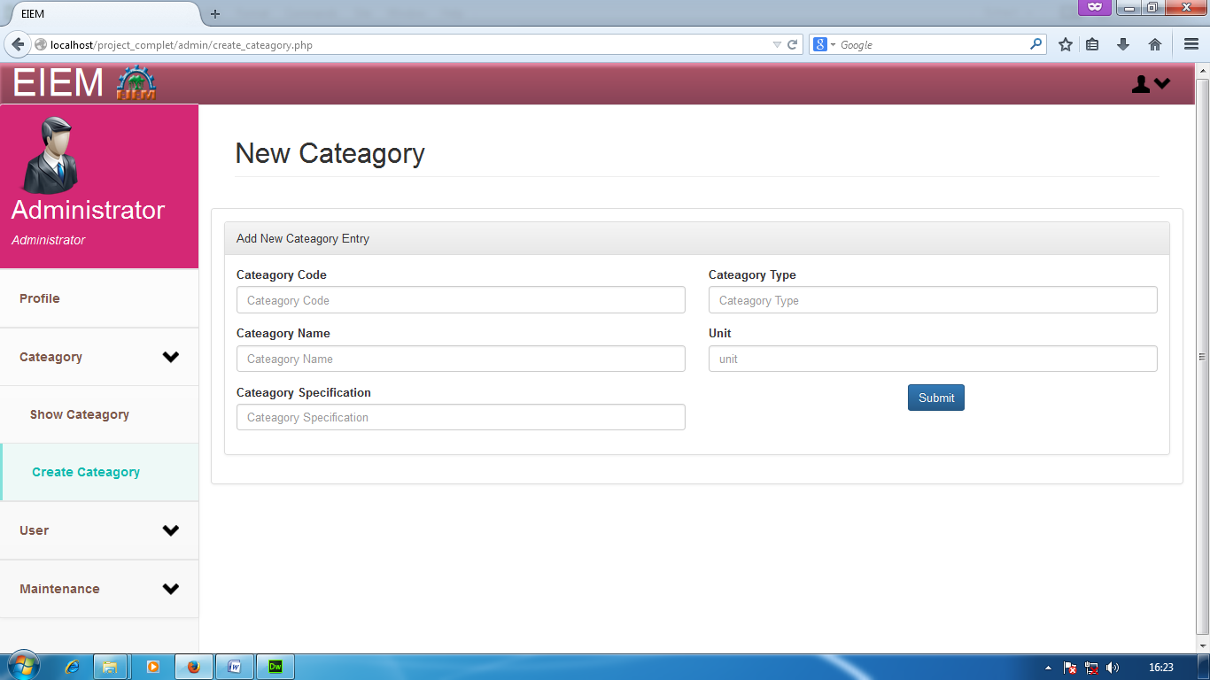
NEW CATEAGORY ENTRY

Slide 32
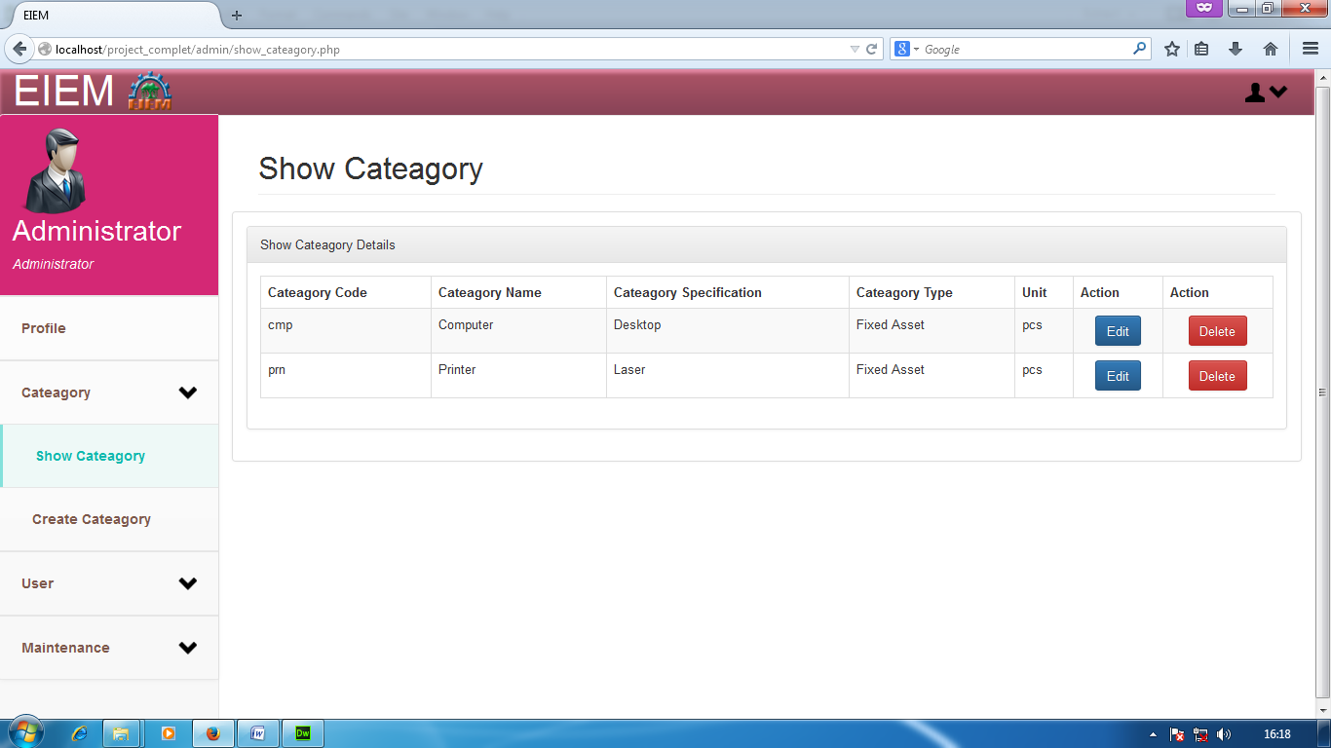
CATEAGORY LIST

Slide 33
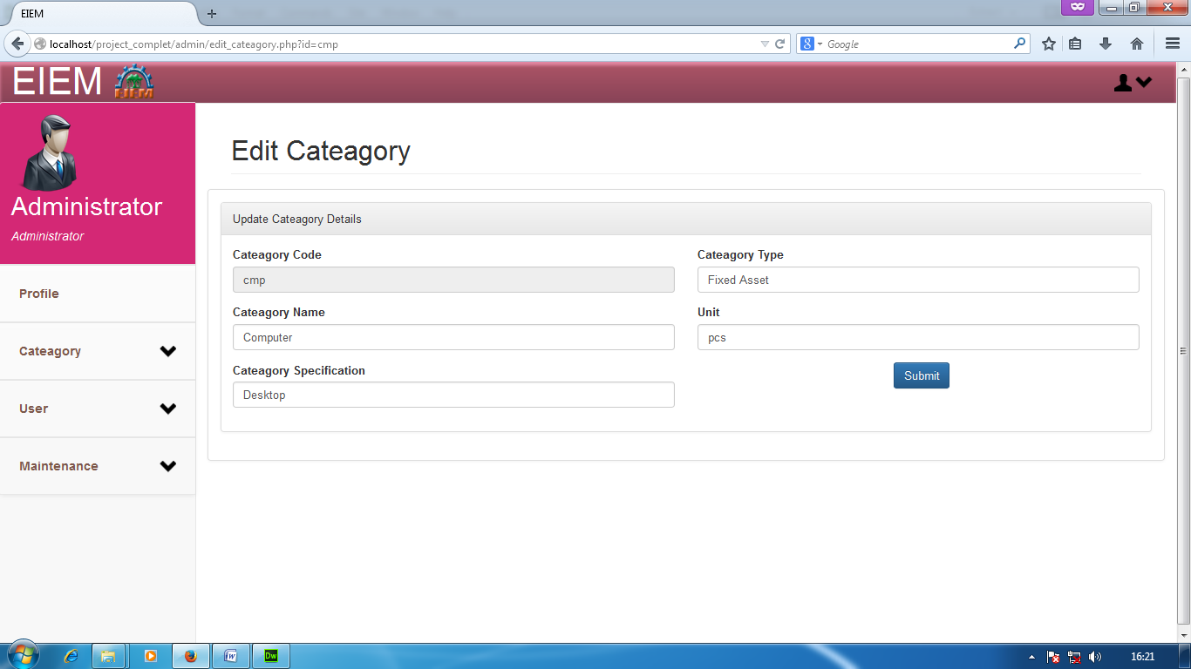
UPDATE CATEAGORY DETAILS

Slide 34
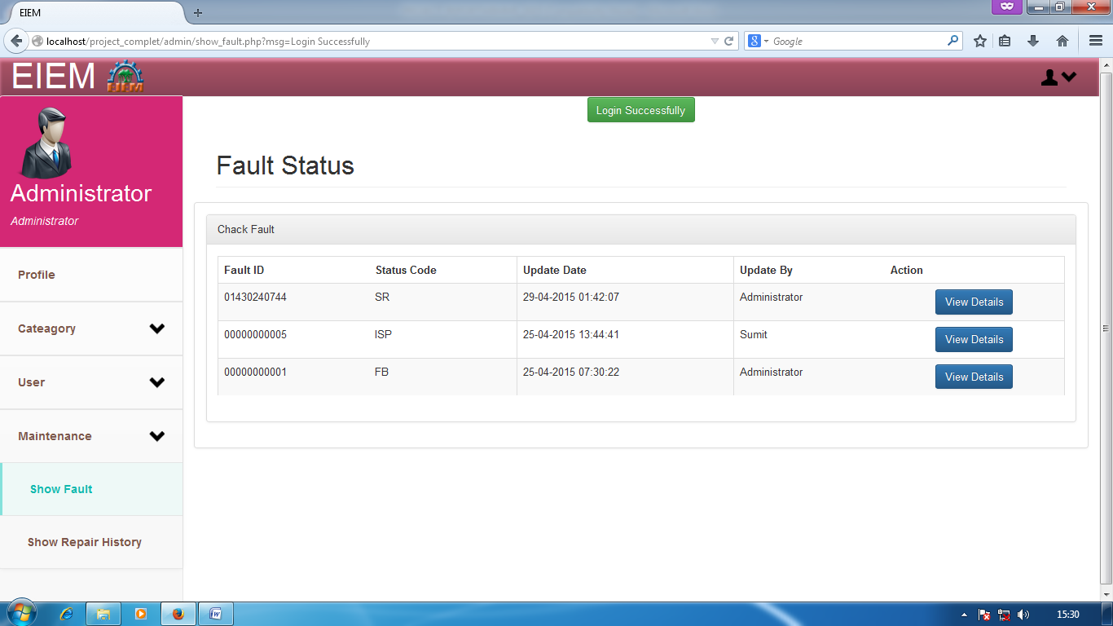
SHOW FAULT LIST

Slide 35
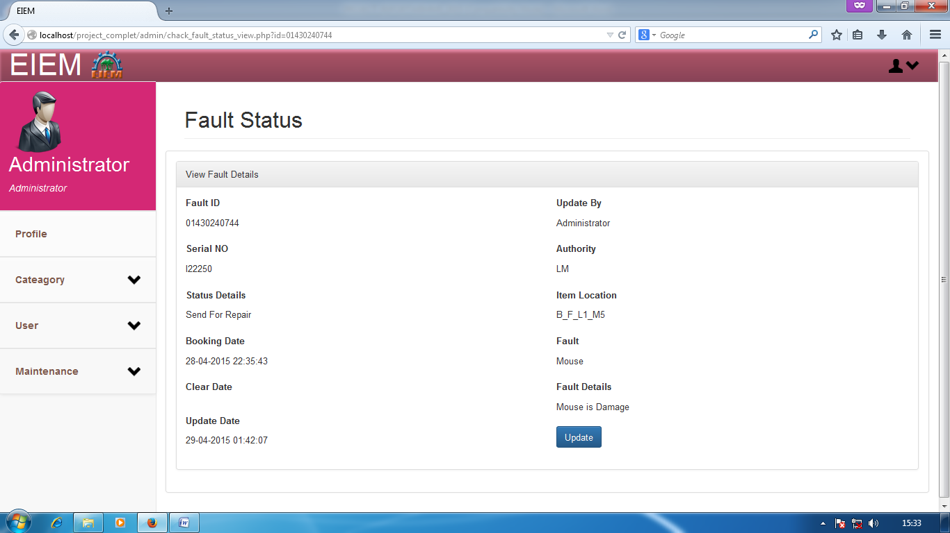
SHOW FAULT DETAILS

Slide 36
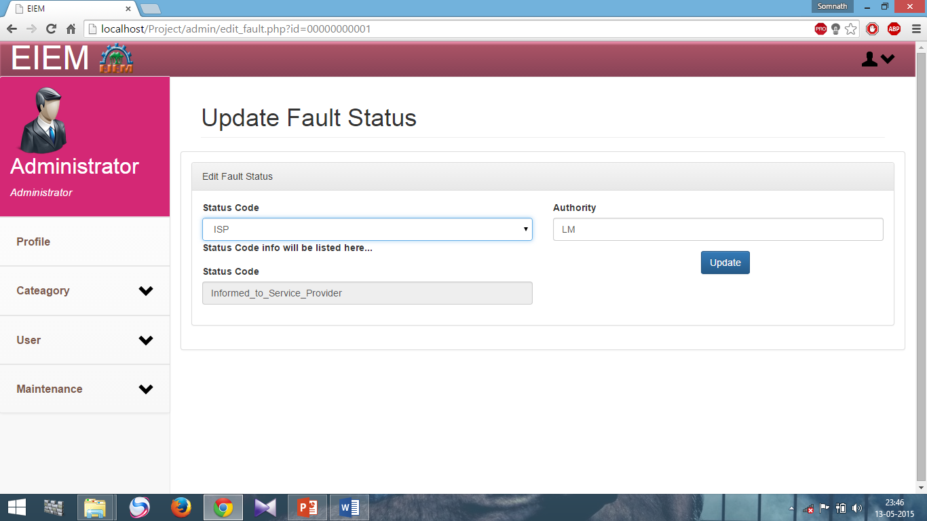
UPDATE FAULT STATUS

Slide 37
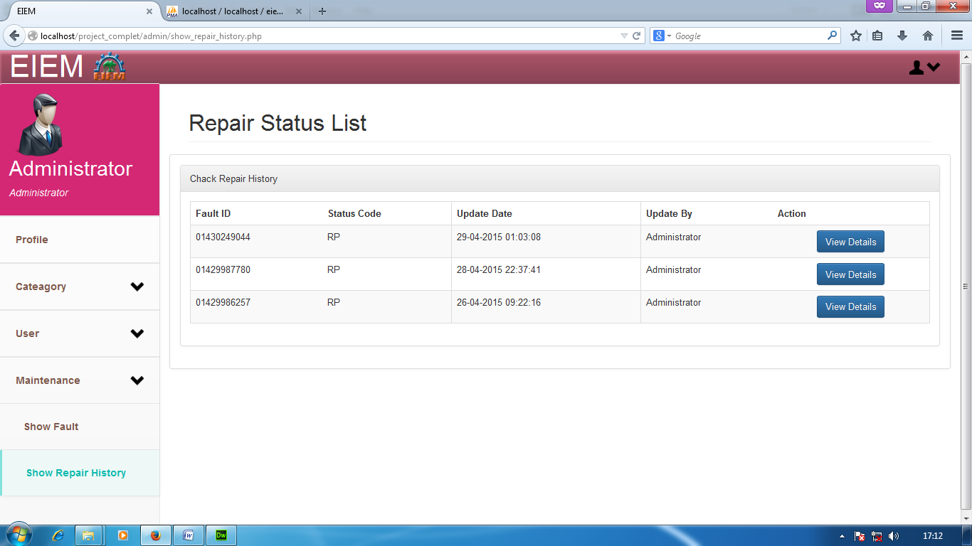
REPAIR LIST

Slide 38
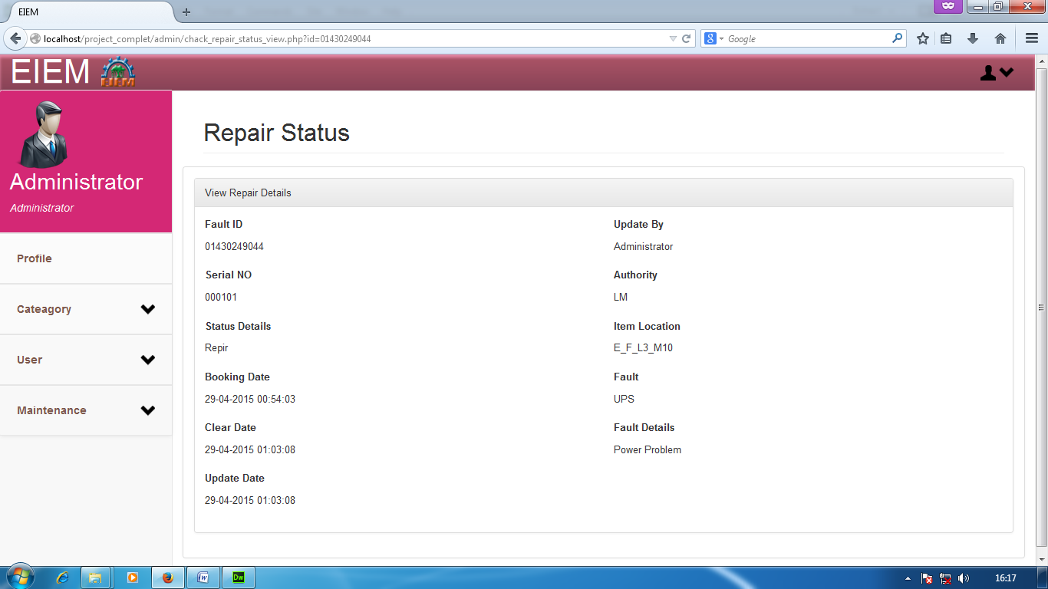
REPAIR DETAILS

Slide 39
USER MODULES

Slide 40
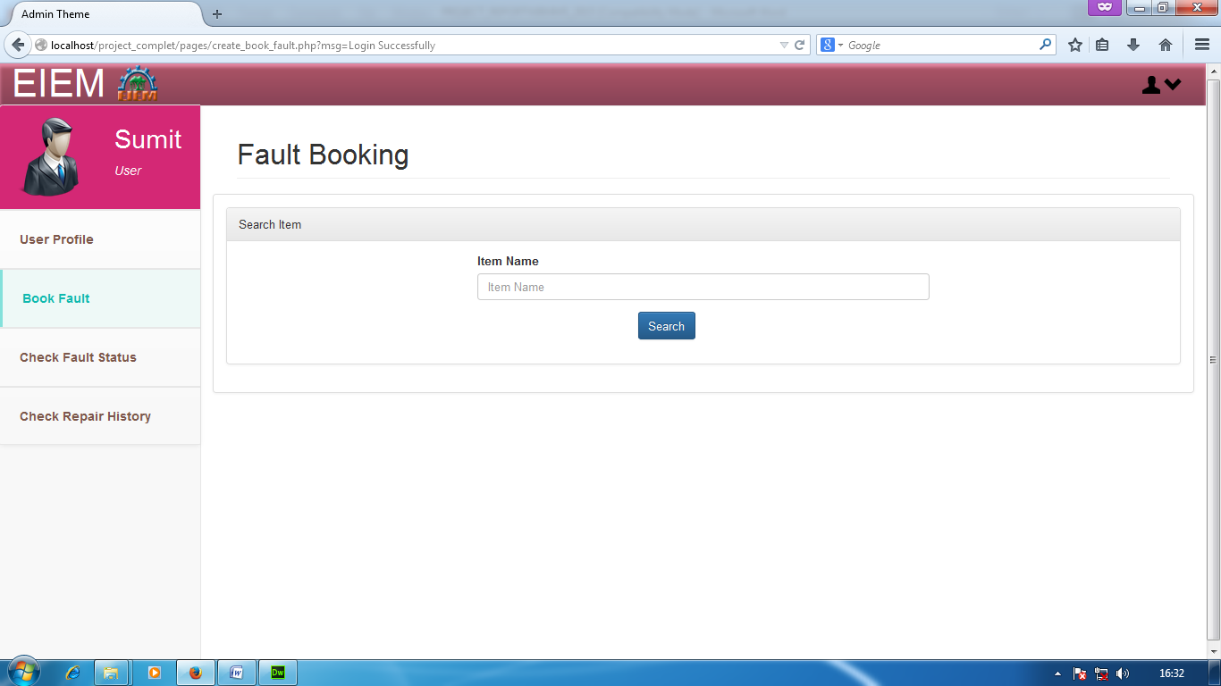
FAULT BOOKING IN SEARCH ITEM

Slide 41
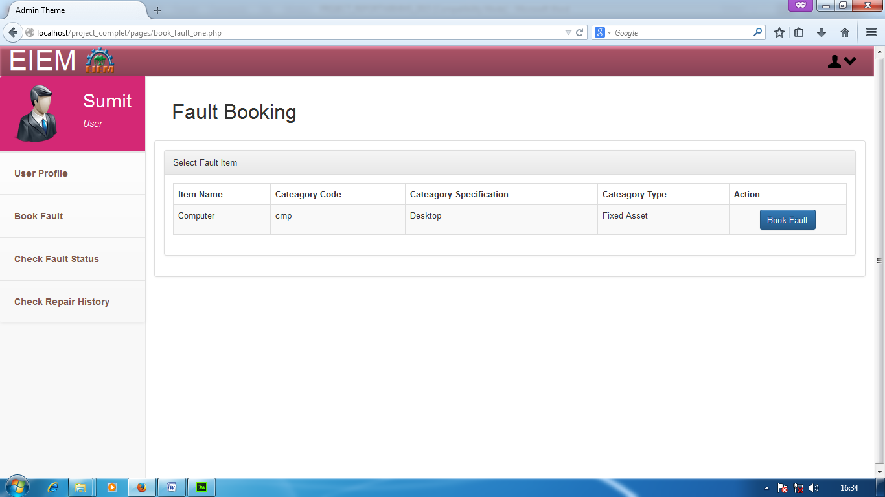
FAULT BOOKING IN SELECT FAULT ITEM

Slide 42
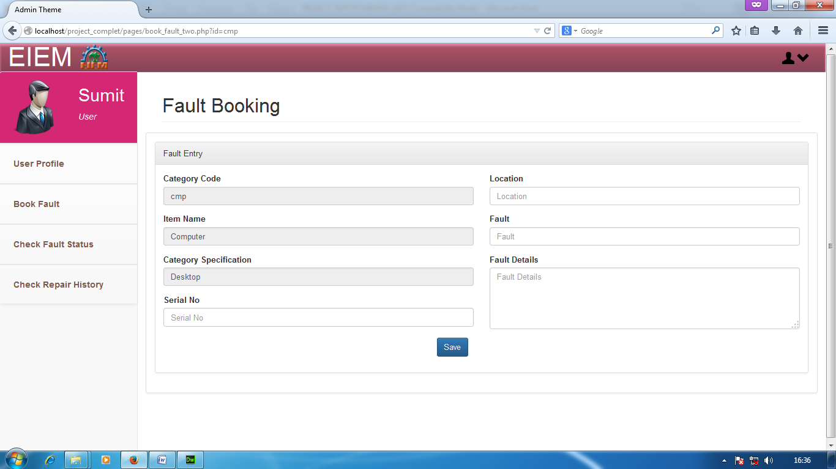
FAULT BOOKING IN FAULT ENTRY

Slide 43
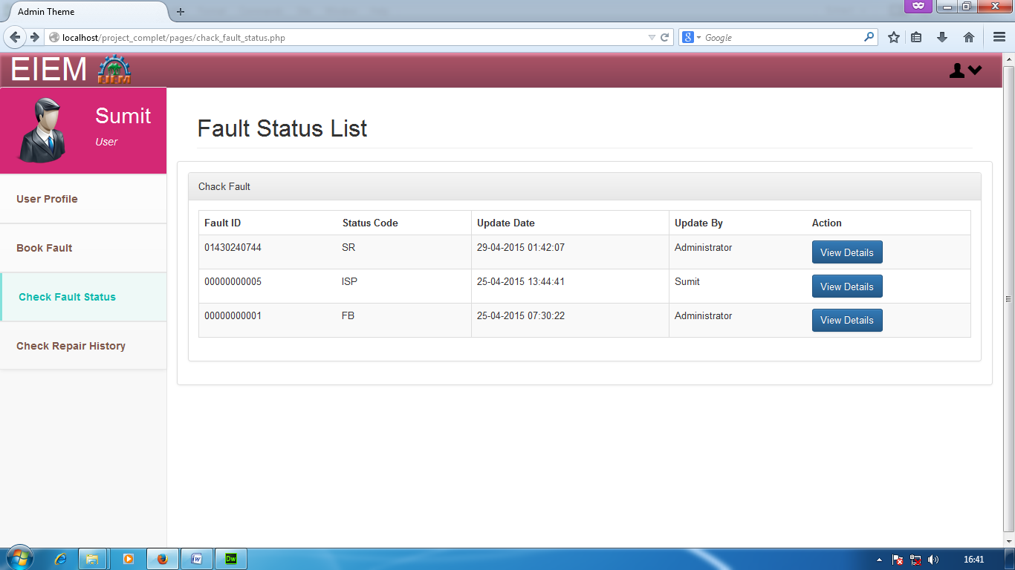
FAULT STATUS CHECKING LIST

Slide 44
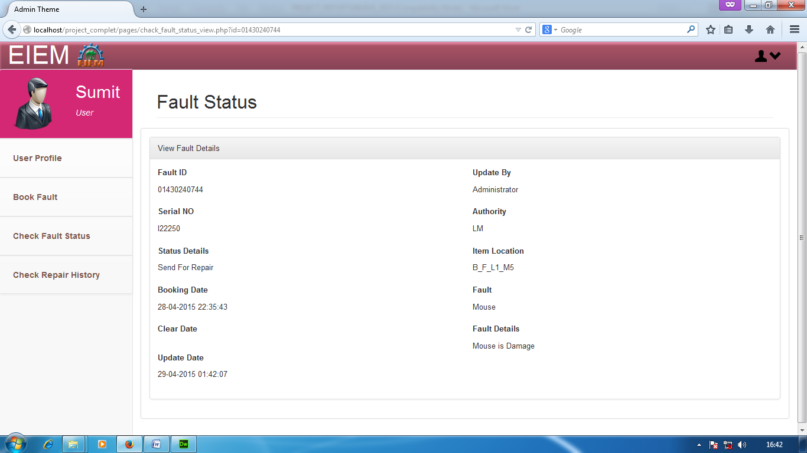
FAULT STATUS DETAILS

Slide 45
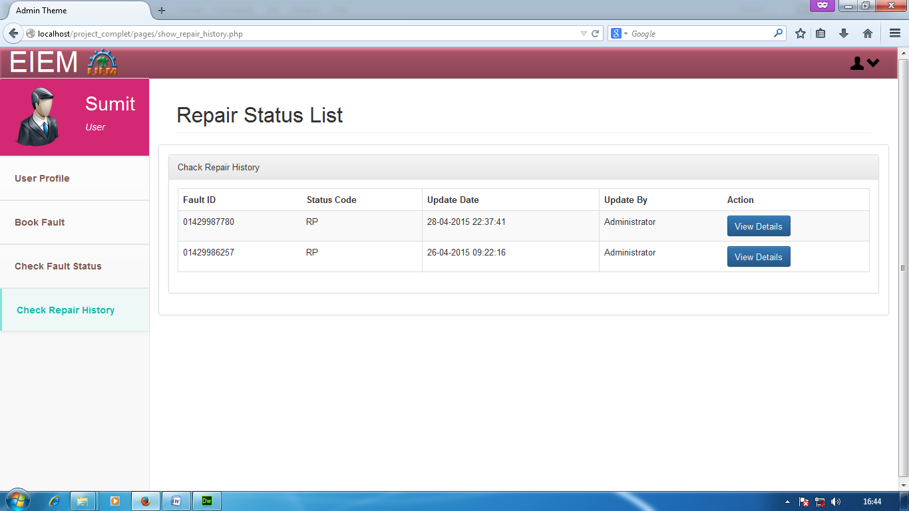
REPAIR STATUS CHECKING LIST

Slide 46

REPAIR STATUS DETAILS

Slide 47
CONCLUSION
The project Web Based Maintenance System is an
automation system of the materials concerned with
locating, maintaining, updating management of
materials of laboratory of an organization.
The project coverage area is the locating and monitoring
all the materials of laboratory then sending them for
repairing if necessary.

Slide 48
LIMITATION OF THE PROJECT
Location details are not maintained, floor wise or building wise.
Printed form reports are not maintained.
Details of vendors are not maintained.
No details of repair history are not maintained.

Slide 49
BIBLIOGRAPHY
www.php.net
www.getbootstrap.com
Google Search Engine

Slide 50
Thank you

